Slide 1

2023 Building/Fire Permit Fee Methodology Change
Information Session for Local Builders/Developers
September 14th (Via Zoom) and September 20th (in person)
Community Development Department Building/Fire Permit Fee Update

Slide 2
Background
Last Update 2019
Conducted Citywide Cost of Service (User Fee) Study
Departments Included
    City Clerk Fire
    Building Parks and Recreation
    Planning Police
    Engineering Transit
    Finance
Community Development Department Tri Annual Building/Fire Code Adoption

Slide 3
Goals in 2019
Survey intended to calculate full cost of providing city services.
Fees can’t exceed estimated reasonable cost of providing the service. GC66014(a).
Building Division Fees
  Changed from valuation to square footage based
  Anything not square footage based, flat fee permit
Results presented to City Council
  Adopted Spring 2020 & Implemented in 2 steps, July and Dec 2020
Community Development Department Fee Methodology Presentation

Slide 4
Issues with Current Fee Schedule
Disproportionately high fees for smaller permits
Difficult to implement in a consistent manner
  Staff time intensive, lots of manual entry
Change in methodology resulted in missing fees
  Many permit types had no fee established
Previous study and time estimates - Needed more work - COVID
Dropped Fire Plan check fee
Homeowners and service trade contractors primarily affected
Community Development Department Fee Methodology Presentation

Slide 5
Proposed Changes
Fee methodology
  Change from Square footage to Construction (valuation) cost
  Still maintain flat fees for more routine, smaller permit, but expand list
Benefits of valuation based methodology
  Reduced line item fees (Included within base fee) ie Permit Issuance fee.
  Scalable to reflect scope of work which dictates city costs.
  More consistent with building fee methodology in other communities.
  Captures scope of work that is not listed as flat fee and creates more predicable.
Benefits to changes to flat fee
  Over-The-Counter permit fees reflect accurate “User Fee”
  HVAC, Water Heater, Windows, ReRoof, Patio Cover, Shed, Etc.
    Modified one size fit all to more scope of work
  Homeowner/Resident friendly
  Simple future adjustments to CPI (consumer price index)
Community Development Department Fee Methodology Presentation

Slide 6
Proposed Changes (cont’d)
Extent of Fee Changes
  Attempting to keep building fees generally in line with prior methodology, while reflecting actual city costs to provide the services
  There are increases to some fees given the cost of services were not accurately reflected in prior time study. Some fees lowered for more routine items. Corrected inspection vs plan check, flipped
  Combination of building permit fees (inspection and plan check) are still within the industry standard of 1-3% of project valuation
Fire Plan Check
  Restore missing Fire Plan check fee, accidently dropped last update
General Plan and Technology Fees
  Slight update General Plan and Technology fee to reflect actual costs
Scope of Update
  Only Updating Building Fees and restoring Fire Plan check fee
  No changes to adopted impact fees, or state-imposed fees (SMIP & Building Standards Administrative)
Community Development Department Fee Methodology Presentation

Slide 7
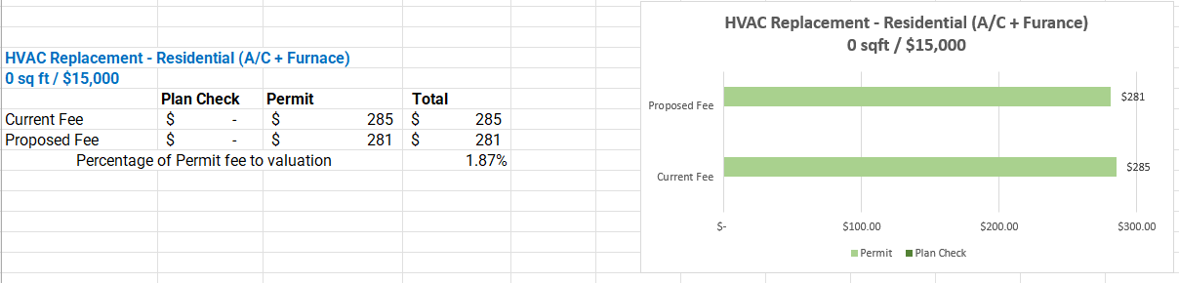
Examples
HVAC Current Permit
Does not include GP update, tech fee, SMIP, Building Standards fee, etc.
Community Development Department Fee Methodology Presentation

Slide 8
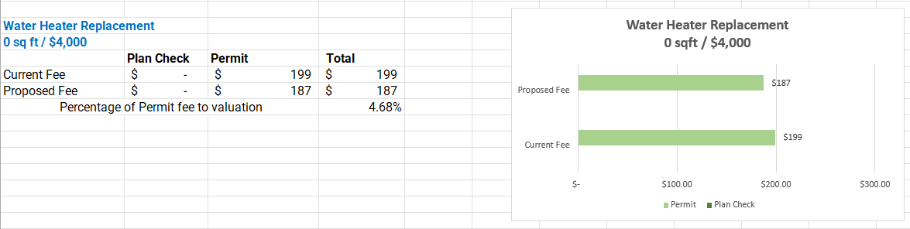
Examples
Water Heater Current Permit
Does not include GP update, tech fee, SMIP, Building Standards fee, etc.
Community Development Department Fee Methodology Presentation

Slide 9
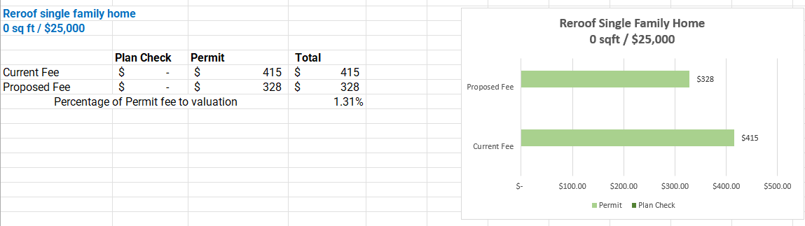
Examples
Reroof Current Permit
Does not include GP update, tech fee, SMIP, Building Standards fee, etc.
Community Development Department Fee Methodology Presentation

Slide 10
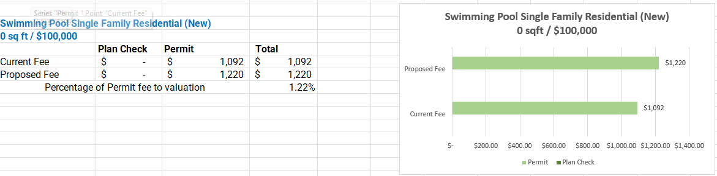
Examples
New Pool Permit
Does not include GP update, tech fee, SMIP, Building Standards fee, etc.
Community Development Department Fee Methodology Presentation

Slide 11
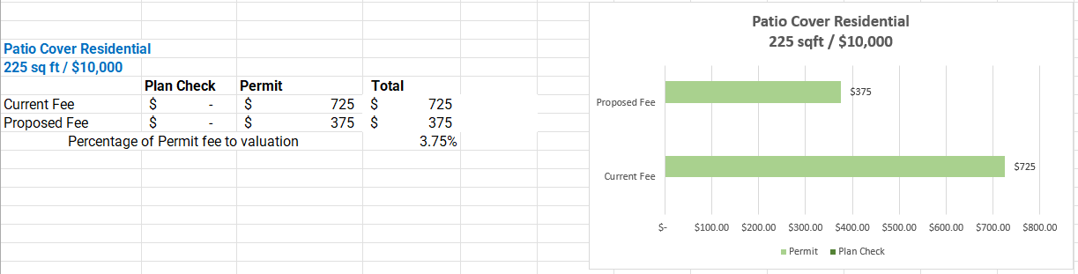
Examples
New Patio Cover Permit
Does not include GP update, tech fee, SMIP, Building Standards fee, etc.
Community Development Department Fee Methodology Presentation

Slide 12
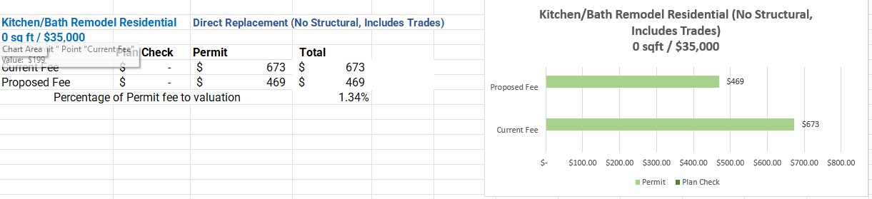
Examples
Bathroom Remodel Permit “Like For Like”
Does not include GP update, tech fee, SMIP, Building Standards fee, etc.
Community Development Department Fee Methodology Presentation

Slide 13
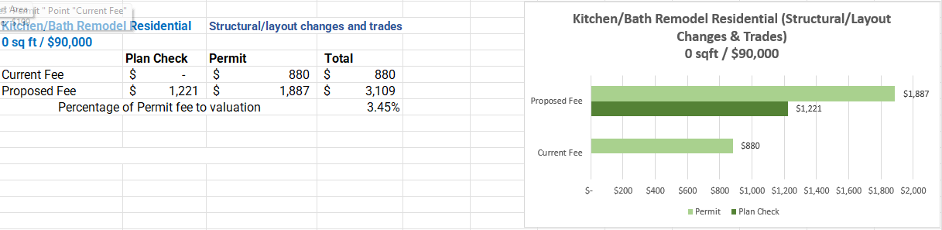
Examples
Bath/Kitchen Remodel Permit W/ Structural, layout changes, and trades
Does not include GP update, tech fee, SMIP, Building Standards fee, etc.
Community Development Department Fee Methodology Presentation

Slide 14
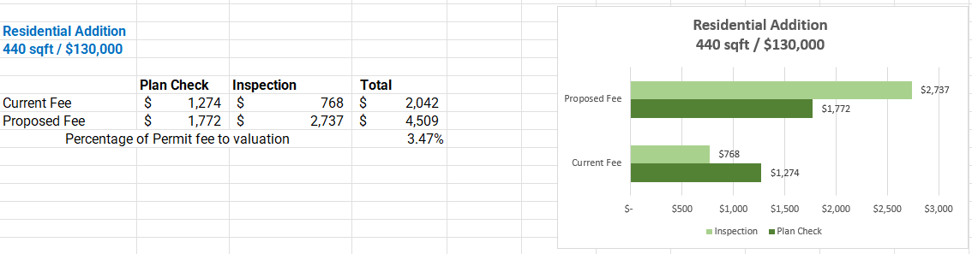
Examples
Residential Addition
Does not include GP update, tech fee, SMIP, Building Standards fee, etc.
Community Development Department Fee Methodology Presentation

Slide 15
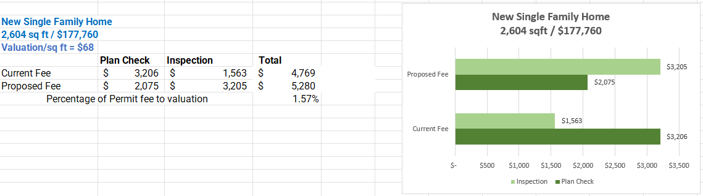
Examples
2175 Maze Way New SFD Permit
Note: Valuation/sq ft = $68
Does not include GP update, tech fee, SMIP, Building Standards fee, etc.
Community Development Department Fee Methodology Presentation

Slide 16
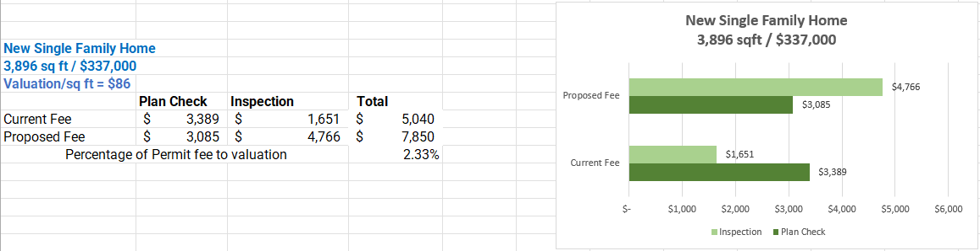
Examples
3,896 SQ FT/$337,000 New SFD Permit
Note: Valuation/sq ft = $86
Does not include GP update, tech fee, SMIP, Building Standards fee, etc.
Community Development Department Fee Methodology Presentation

Slide 17
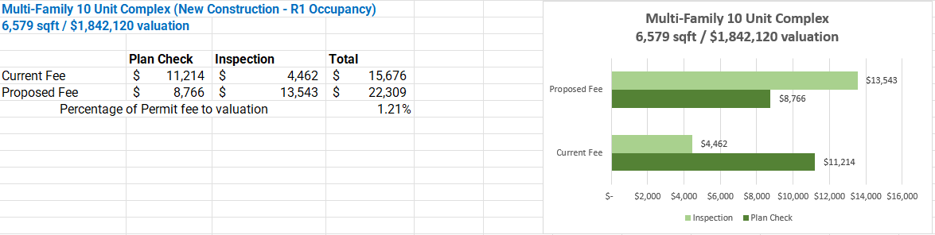
Examples
Multi-Family 10 Unit Complex (New Construction)
Does not include GP update, tech fee, SMIP, Building Standards fee, etc.
Community Development Department Fee Methodology Presentation

Slide 18
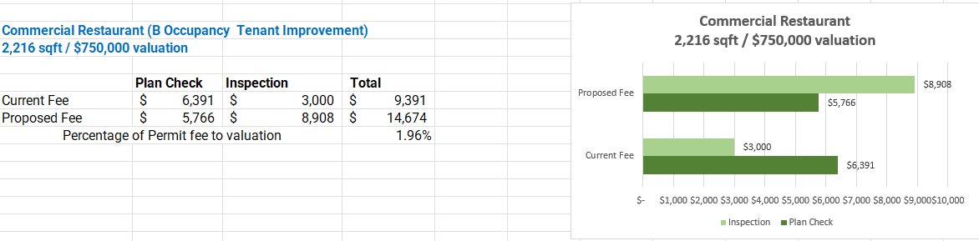
Examples
Commercial Restaurant (A2) - Tentant Improvement
Does not include GP update, tech fee, SMIP, Building Standards fee, etc.
Community Development Department Fee Methodology Presentation

Slide 19
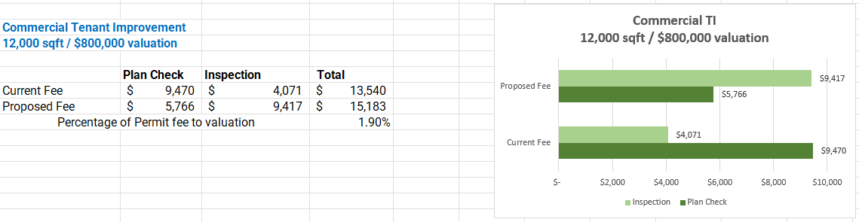
Examples
Commercial Tenant Improvement
Does not include GP update, tech fee, SMIP, Building Standards fee, etc.
Community Development Department Fee Methodology Presentation

Slide 20
General Plan & Tech Fee
General Plan Fee
  Current Fee = $5.82/$1,000 valuation
  Proposed Fee = $6.01 /$1,000 valuation
Technology Fee
  Current Fee = $35 flat fee. Does not cover costs to improve technology for permitting
  In process of implementing new Permit tracking (Tyler EnerGov, on line portal, blue beam)
  Proposed Fee to cover cost of new software
    8.00% of building permit fee would cover both the Fund 108 budgeted costs as well as the annual costs associated with the Tyler permitting system.
  Examples of the tech fee based on our new permit fee methodology
    Commercial Tenant Improvement , valued at $750,000. Permit fee would be $8,908, therefore proposed Tech Fee would be $712
    New Single family home, valued at $337,000. Permit fee would be $4,766, therefore proposed Tech Fee would be $381
    Patio cover, valued at $10,000. Permit fee would be $375, therefore proposed Tech Fee would be $30
Community Development Department Fee Methodology Presentation

Slide 21
BSARF & SMIP Fees
Building Standards Administration Special Revolving Fund SB 1473
  Development, adoption, publication, and updating of green building standards (training, education, etc.) Up to 10% may be used by jurisdictions for these purposes.
    Current Fee = $1.00 up to $25,000 plus $1.00 for each additional $25,000
    Proposed Fee = No Local Change – California Legislation
Strong Motion Instrumentation Program
  The information gathered by CSMIP is processed and disseminated to seismologists, engineers, building officials, local governments and emergency response personnel throughout the state. The data is used to develop recommended changes to seismic provisions of building codes, to assist local governments in their general plan process and to aid emergency response personnel in the event of a disaster. Founded 1972
    Current Fee = (Valuation Amount) X 0.00013 with Min $.50 < $3,850
    Proposed Fee = No Local Change – California Legislation
  Note: Category 1 construction includes residential buildings 1 to 3 stories in height except hotels and motels. Condominiums and Apartments less than 4 stories
Community Development Department Fee Methodology Presentation

Slide 22
Questions
Thank you. Questions?????
Larry Paisley, Chief Building Official
Raffi Boloyan, Community Development Director
Community Development Department Fee Methodology Presentation

